Slide 1

Benevera Health: Avoidable Emergency Department Visits
Project Team: Kiana Brigham, Sindhu Veeramacheneni, Zachary Zalman
Benevera Liaison: Steven Glover

Slide 2
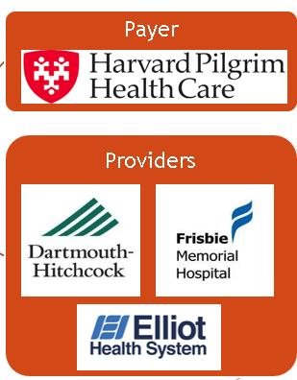
A Quick Recap of Benevera Health
Benevera Health is a joint venture between payer and providers.
Benevera Health is a Population Health Management Company
Analytics Team
Utilizes EMR, Claims, and Member data to target at risk patients, as well as patients with chronic and emerging conditions
Health Care Team
Breaks down medical, mental/behavioral, financial, housing, transportation needs and helps patients meet these needs

Slide 3
Members are not seeking ED care in the proper way.
Associated Costs
Patients
Physical toll associated with putting off primary care visits
Accumulating medical bills
Insurance Companies
Paying more for expensive ED treatment versus less costly primary care treatment
Hospitals
Using resources on avoidable ED patients
Bankruptcies

Slide 4
How do we reduce the amount of avoidable emergency department visits?
Predict patients that will have a high risk of unnecessary emergency room visits in the next 3-6 months
Identify circumstances in which a person accesses the emergency department for avoidable reasons at higher rates

Slide 5
We analyzed the data in multiple ways
Exploratory Data Analysis
Comparing the avoidable ED visits to unavoidable ED visits
Machine Learning
Random Forest
Deep Learning
Vanilla Neural Network with binary classification
Logistic Regression
KMeans Cluster Analysis

Slide 6
The structure and contents of the datasets are complex.
Structure of Dataset
Each row of the dataset is a line item of a claim that captures one procedure/service and the corresponding liabilities.
Each row of the dataset corresponds to an insurance plan and the time span it covers.
Broader Categories for Variables
Member Information
Diagnoses
Prescription Information
Liabilities
Servicing Provider
Procedures/Services
Payer Designated PCP
Demographic Information
Plan Design
Payer Designated PCP
Disease Management/ Care Management Flags
Size of Dataset
14.6 Million Rows
124 Columns
792,802 Rows
133 Columns
Claims Data
Member Data

Slide 7
Avoidable Emergency Department visits are a small fraction of overall medical claims.

Slide 8
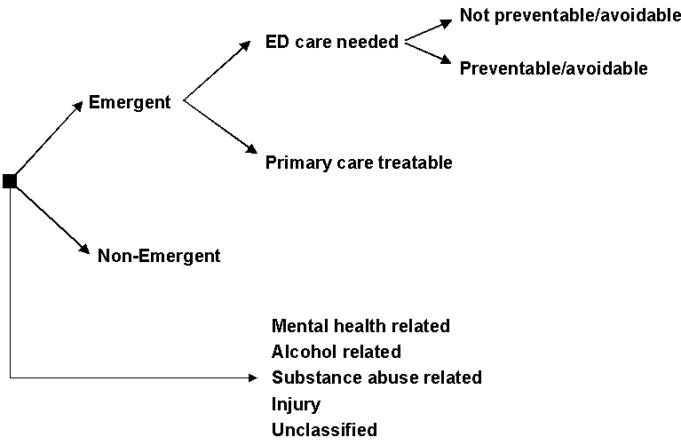
The NYU ED Avoidable Algorithm is used to create a response variable.
Four categories:
Non-Emergent
Emergent - Primary Care Treatable
Emergent – ED Care Needed – Preventable/Avoidable
Emergent - ED Care Needed - Not Preventable/Avoidable
Avoidable Flag Conditions
Has one of the 10 procedure code within the claim that corresponds to the emergency room, and/or a facility code corresponding with a hospital emergency room
Greater or equal to 0.5 for Non-Emergent, Emergent- PC Treatable, Emergent ED Care Needed Preventable/Avoidable for the primary ICD code

Slide 9
Preparing medical data for analysis requires many steps
Create a sample of the claims dataset
Word2Vec ICD columns and Procedure Code Columns
Compile line items for each claim into one row
Merge Claims and Member dataset
Backflag all medical claims up to 6 months prior to an avoidable claim
One-hot encode all categorical variables and standardize numerical variables
Create avoidable and unavoidable emergency department flags
Principal Component Analysis
Used resample to adjust minority class
Notes:
Steps:
Create a sample of the claims dataset -> take a small portion of the data due to limited computing power
Create avoidable and unavoidable emergency department flags -> create labels for ER visits using the NYU algorithm
Word2Vec ICD columns and Procedure Code Columns -> turn the codes into vector representations using Word2Vec trained on the codes (ICD and Procedure codes were trained and coded separately)
Compile line items for each claim into one row -> aggregate all the data for one claim into a single row
Merge Claims and Member dataset -> create one dataset out of the two
Backflag all medical claims up to 6 months prior to an avoidable claim -> add an avoidable/unavoidable tag to non-ER claims, based on a previous ER visit (or lack of one). This is done on the member level, so the claims for each member were treated separately from each other
One-hot encode all categorical variables and standardize numerical variables -> process the data into a mathematically useable form
Principal Component Analysis -> dimension reduction used only for the exploratory data analysis
Used resample to adjust minority class -> balance the number of avoidable and unavoidable claims

Slide 10
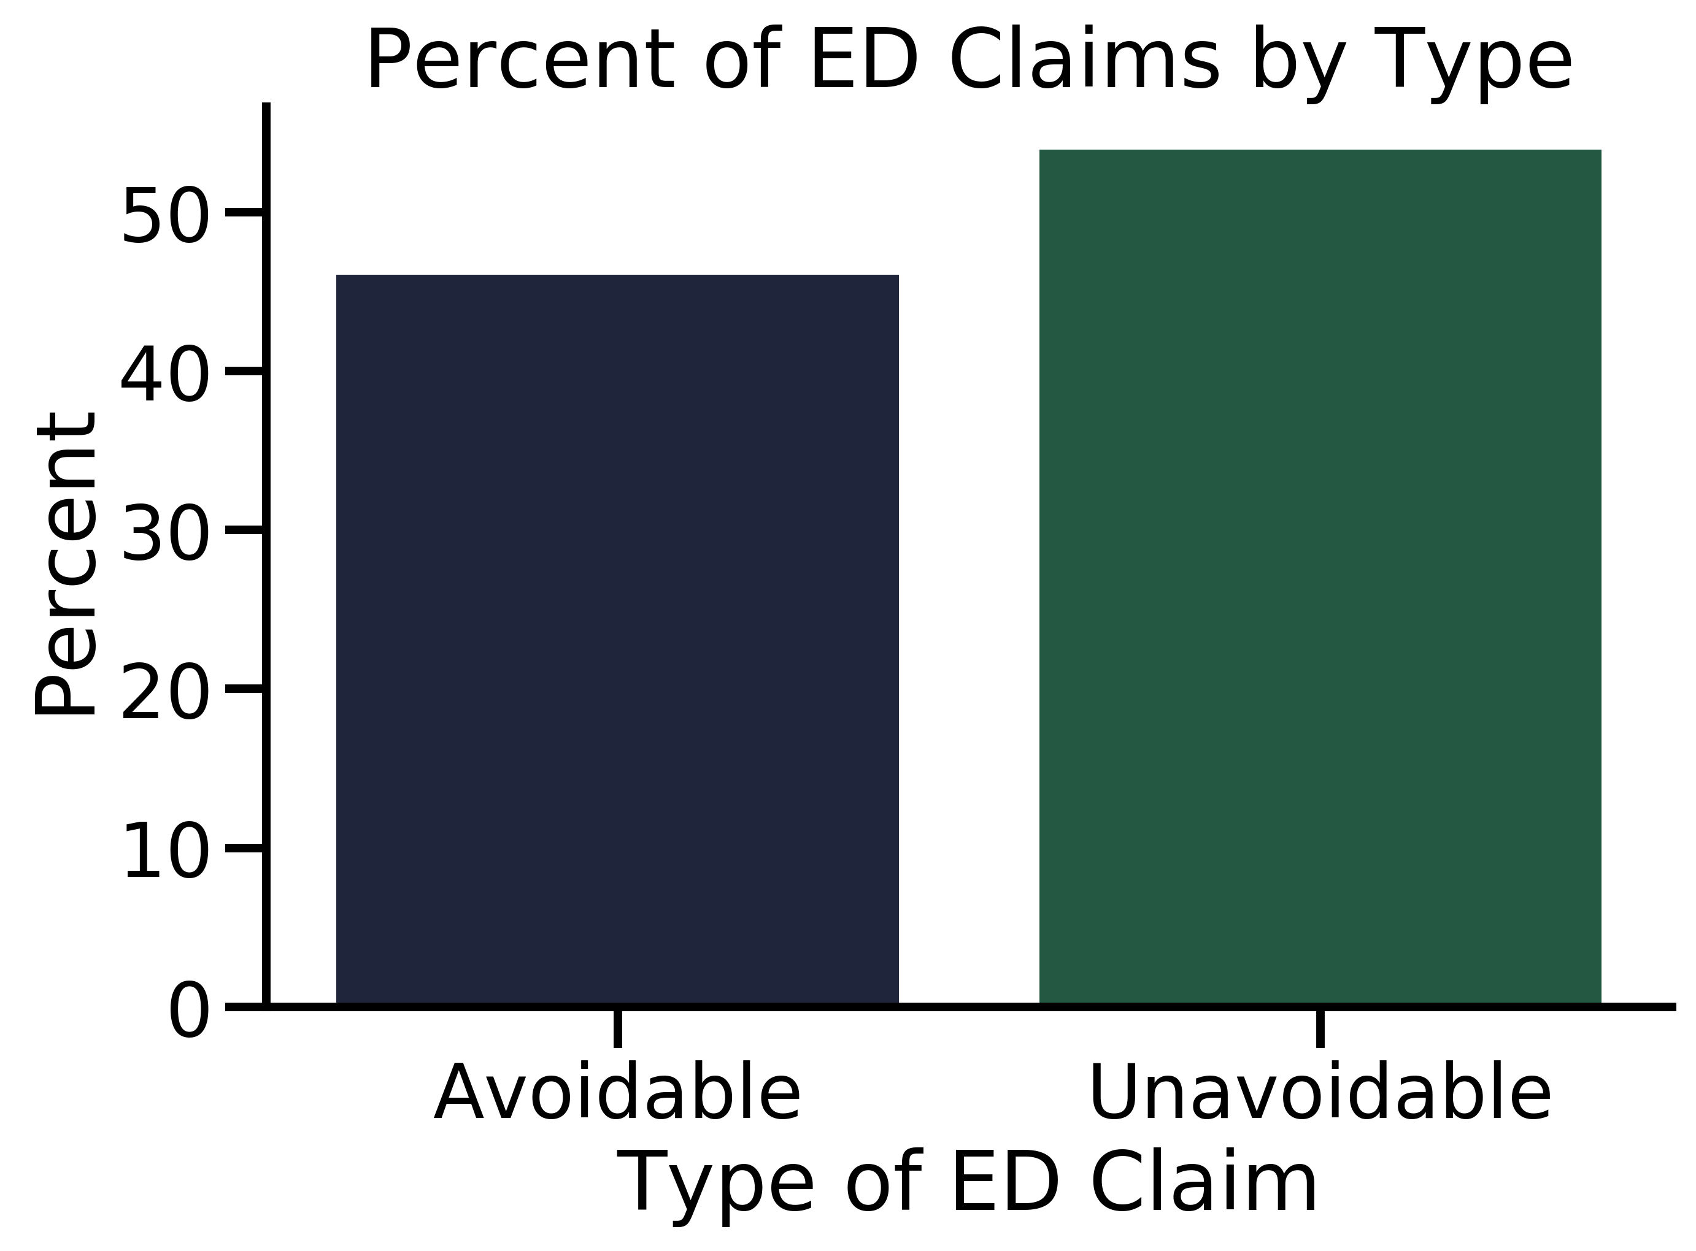
Overall, there is a higher percent of unavoidable emergency department claims.
46.1%
53.9%

Slide 11
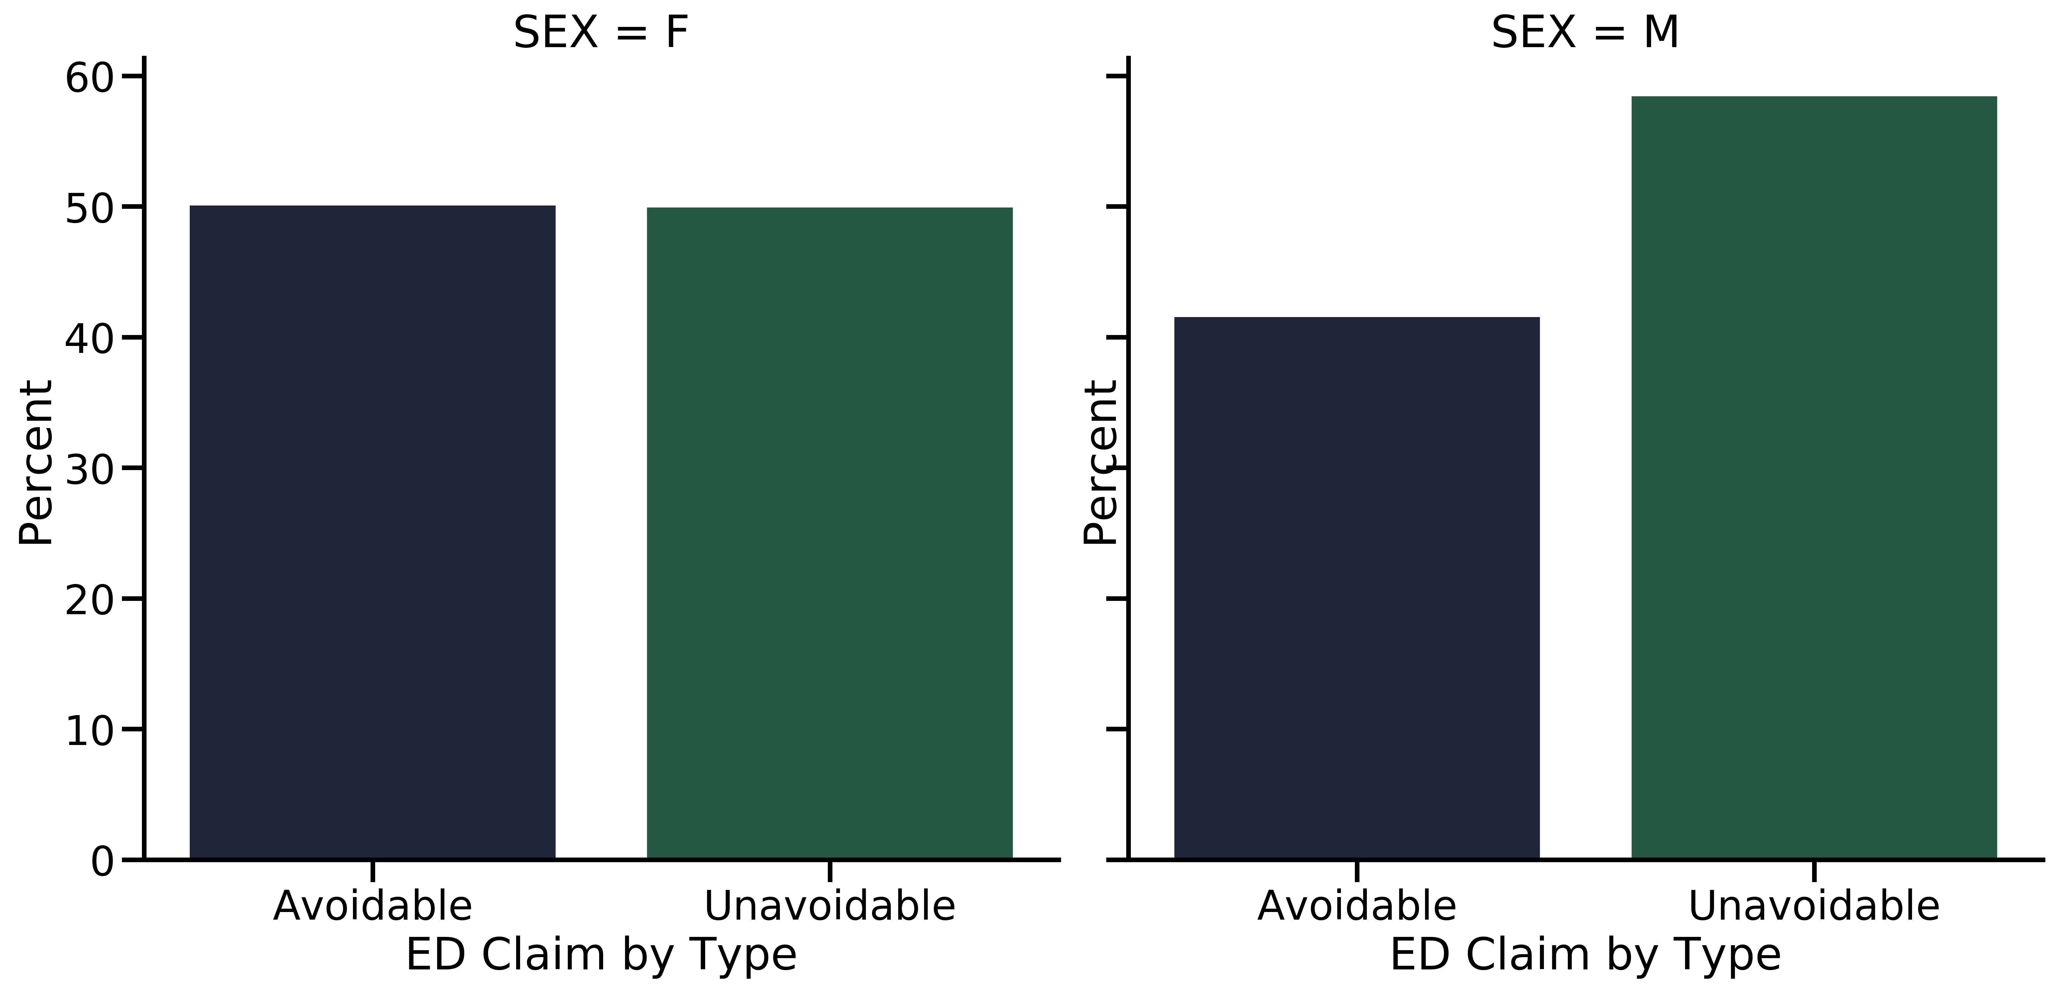
Women access the emergency department for avoidable and unavoidable reasons at equal rates. Males access the emergency department for avoidable reasons at lower rates.
Percent of Avoidable/Unavoidable Claims by Sex
50.1%
49.9%
41.5%
58.5%

Slide 12
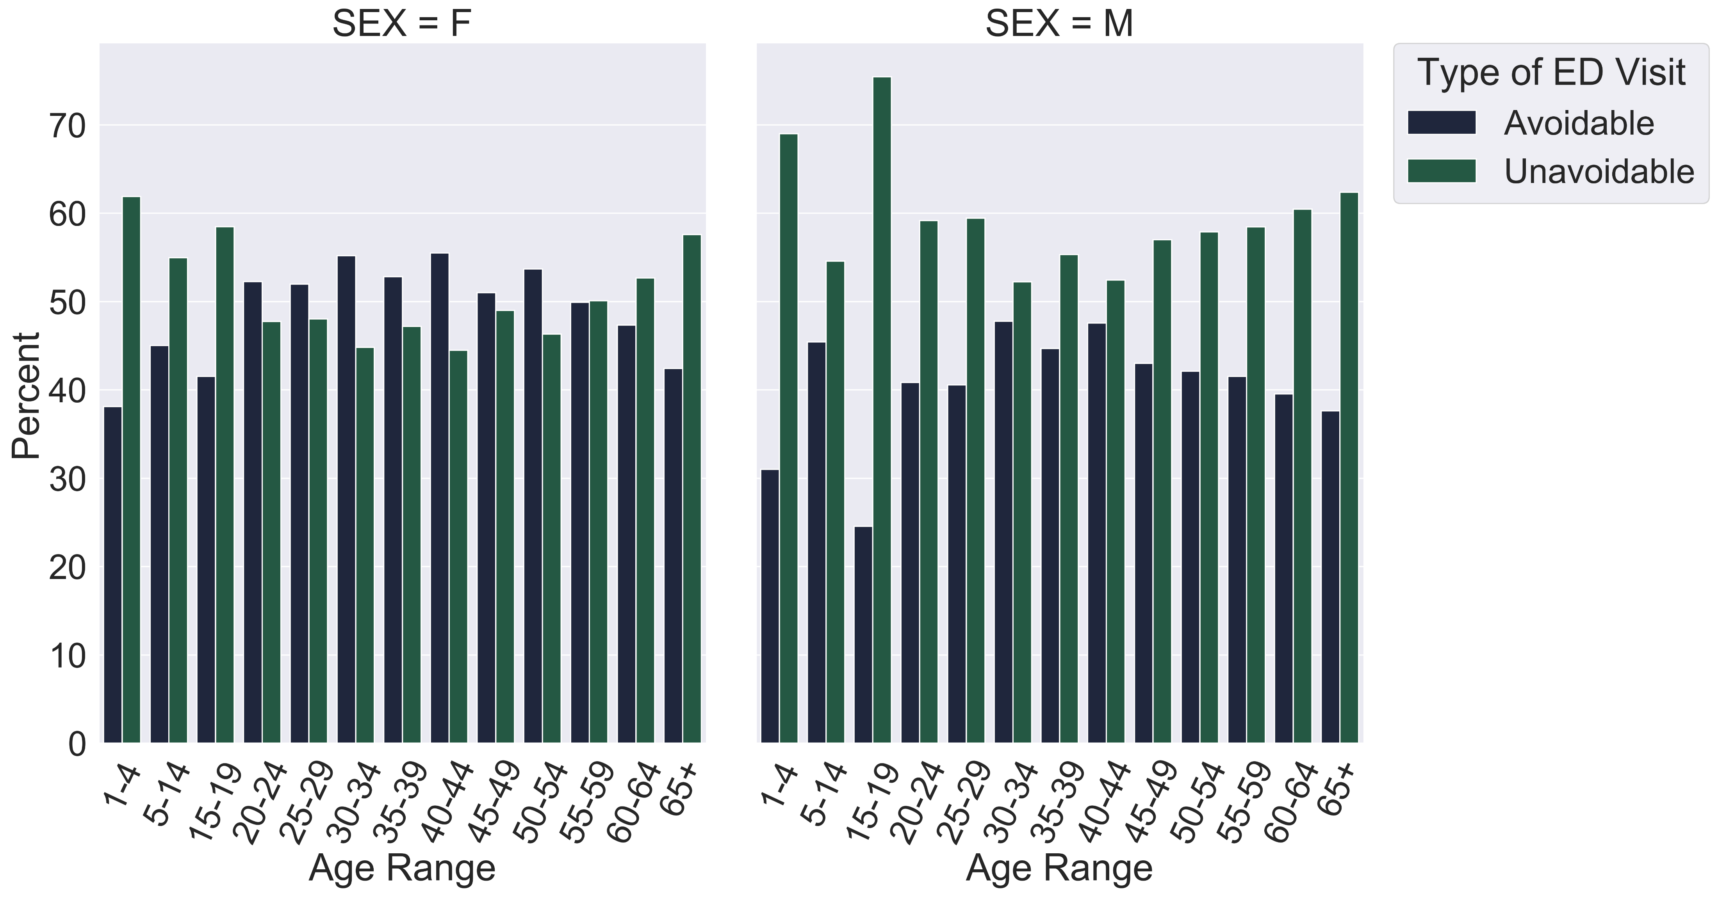
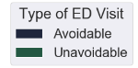
For women, the 20-24 to 50-54 age categories had higher percentages of avoidable visits than unavoidable. For men, every age category has a higher percentage of unavoidable visits.
Percent of Avoidable/Unavoidable Claims by Sex and Age

Slide 13
These are the top reasons men and women are accessing the emergency department
Male Avoidable | Male Unavoidable
Other chest pain | Chest pain, unspecified
Headache | Major depressive disorder, single episode
Low back pain | Fainting and collapse
Acute upper respiratory infection | Fever
Dizziness and giddiness | Unspecified injury of head
Female Avoidable | Female Unavoidable
Other chest pain | Chest pain, unspecified
Headache | Urinary Tract Infection
Abdominal pain | Fainting and collapse
Epigastric pain | Palpitations
Low back pain | Noninfective gastroenteritis and colitis

Slide 14
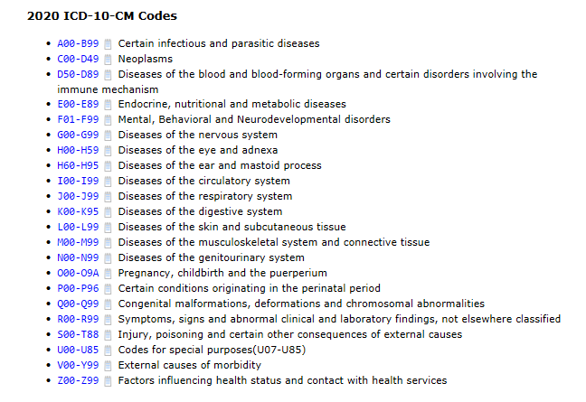
Process for Clustering Avoidable Events
10 columns of ICD codes
ICD 10 Module to convert each ICD code into one of 21 Broad Categories
Countvectorizer
KMeans
Countvectorizer: Tokenizes each ICD category and creates a vector with the count of how many times the category appears in each claim

Slide 15
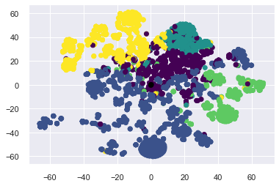





KMeans Resulted in Five Clusters
TSNE Representation of Clusters
Mental Struggles
Younger Inexpensive Visits
Elder Females
Elder Males
Unclassified
TSNE 2
TSNE 1

Slide 16
Each cluster has a set of features that defines how it is different from the other clusters.
Mental Struggles
Younger Inexpensive Visits
Elder Female
Elder Male
Unclassified
2nd Highest Average Cost Per Claim
2nd Highest Percentage of Medicare Patients
Highest Mental/ Behavioral
Highest Digestive
Highest Percentage of Commercial Plans
Lowest Average Age
Lowest Average Cost per Claim
Lowest Circulatory, Endocrine/ Nutrition/ Metabolism
Highest Eye/Adnexa
Highest Percent Female/ Lowest Percent Male
Highest Average Age
Highest Avg Total Cost Per Claim
Highest Percent Medicare
Highest Circulatory, Nervous System, Respiratory, Endocrine/ Nutrition/ Metabolism
Highest Percent Male/ Lowest Percent Female
Lowest Digestive, Eye/Adnexa, Genitourinary, Pregnancy/ Birth
Highest External Causes, Injury/Poisoning, Musculoskeletal/Connective
Nothing stands out demographically
Highest Unclassified Diagnoses by far (at least 3 times all other groups)

Slide 17
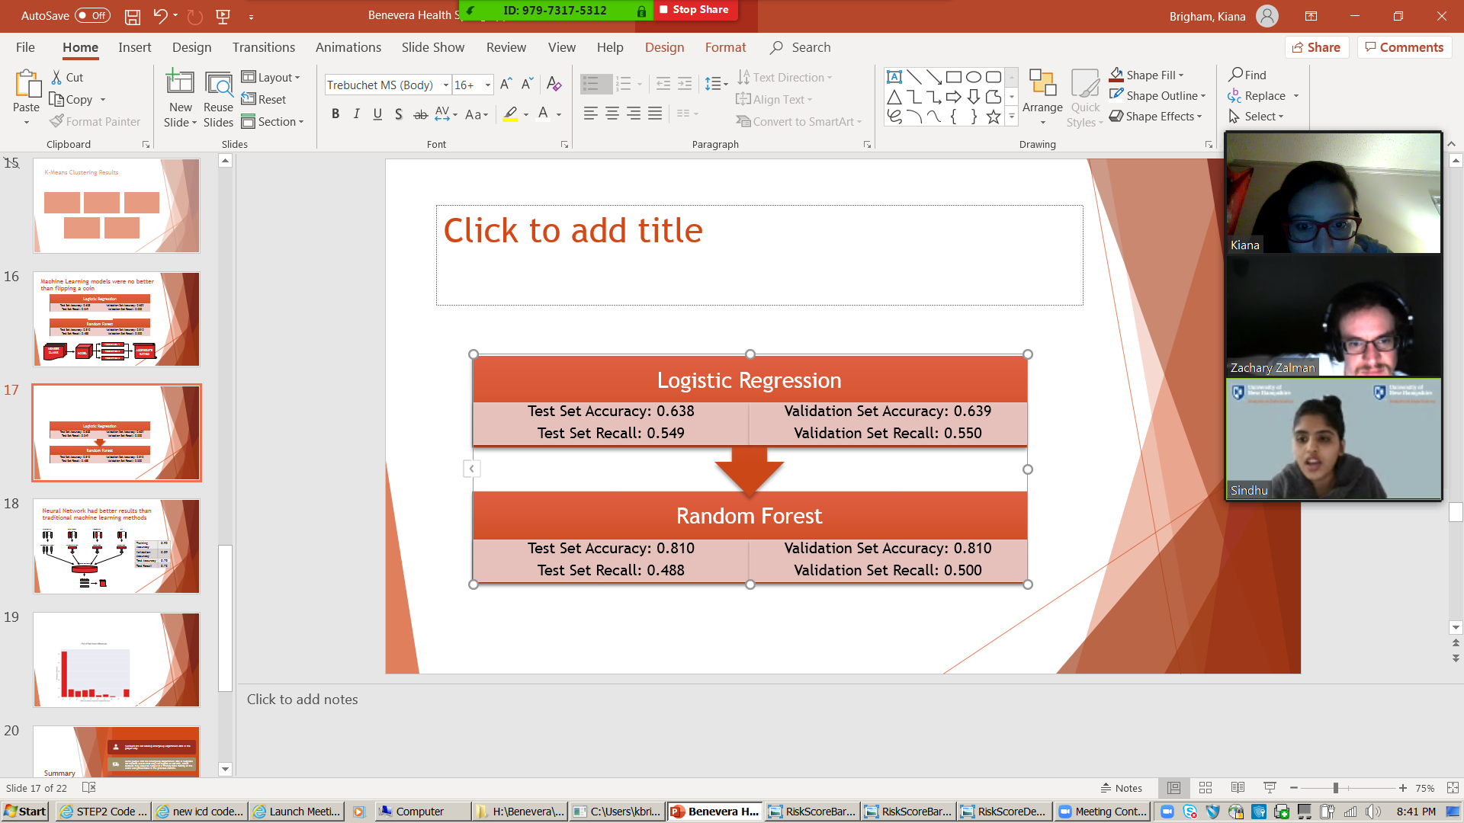
Machine Learning models were no better than flipping a coin
Recall: Percentage of total avoidable results correctly classified by algorithm
MEMBER
CLAIMS
PREDICTION 1
AGGREGATE
RATING
MODEL
PREDICTION 2
PREDICTION 3

Slide 18
Neural Network had better results than traditional machine learning methods
Categorical
Variables
Continuous
Variables
Procedure
Variables
ICD
Variables
Training Accuracy | 0.92
Validation Accuracy | 0.89
Test Accuracy | 0.75
Test Recall | 0.73
…
…
…
…
Embedding Layers
Standardization
Word2Vec
Word2Vec
…
Accurate Prediction | 0.75
Incorrectly Predicted Avoidable | 0.23
Incorrectly Predicted Unavoidable | 0.02
Dense Network
Predictions
Ranking
…

Slide 19


Calculation for the Difference Between Actual and Predicted Avoidable Events
Predicted Avoidable Events
= 4/10 = 0.4
The difference between the Actual events and the Predicted events is 0.1
Actual Avoidable Events
= 3/10 = 0.3

Slide 20
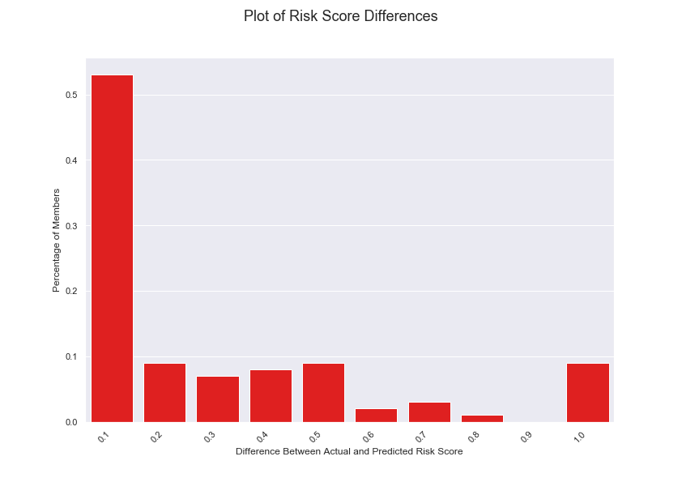
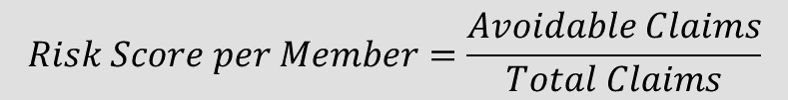
Based on our results, there is a difference between risk scores calculated from the actual and predicted avoidable visits predicted
$$Risk Score per Member=\frac{Avoidable Claims}{Total Claims}$$

Slide 21
Summary
Members are not seeking emergency department care in the proper way.
Some people visit the Emergency Department (ED) in hospitals for medical events that may not require an ED visit, either because they could be helped at a Primary Care facility or the event was preventable in the previous months.
Can we predict which patients are more likely to have an avoidable ED visit in the next 3-6 months?
We examined multiple traits between avoidable and unavoidable visits as well as conducted machine learning for prediction with varying success. Neural network is the most promising.

Slide 22
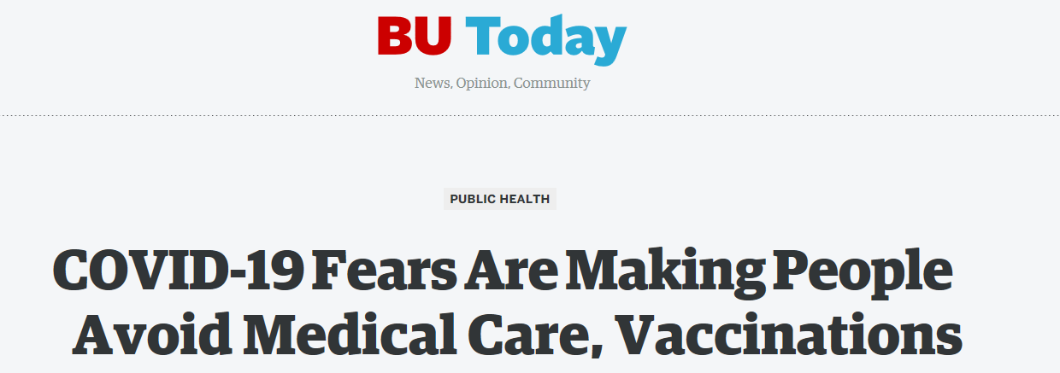
Covid-19 changes everything
Implications
This problem becomes more important: need to keep avoidable visitors out of ED to treat coronavirus patients (especially in NY, NJ)
Over 26 million filed for unemployment in the past couple months and many also lost medical insurance

Slide 23

Questions?

